Slide 1
Alojz Gomola
Emergency ACAS-XU implementation
21st January 2018
Using Obstacle Avoidance Framework Based on Reach sets

Slide 2


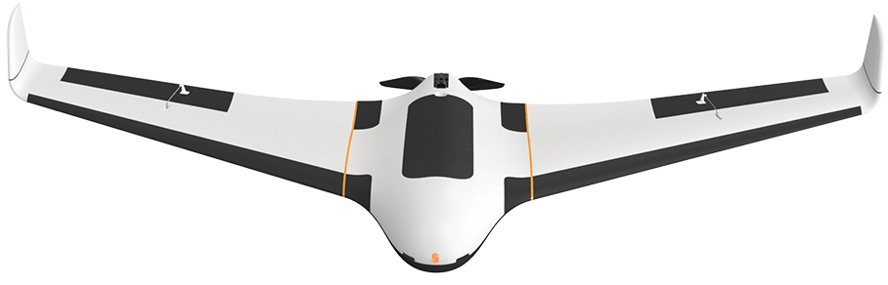

You can have nice weekend, but there is idea looming around ….
UAV wants To chat
Look at your phone

Slide 3

A little chat with UAV…
Lojzo, I was thinking, that you should implement ACAS-XU avoidance mechanism into your framework ...
ACAS is using avoidance trajectory tree to avoid collisions ….
That is our REACH set right ?
Well, but we are using a different cost function for navigation …
Switching mode control will do …
Well, I propose to implement Switching mode control between:
ACAS custom reach set
Standard cost function reach set

Slide 4
Idea in nutshell
Implement ACAS emergency avoidance in current Obstacle avoidance framework
But we need Rule Engine to do That ...
Some features like cost based decisions can be covered under current framework:
ACAS avoidance tree – just favor vertical separation instead vertical.
Other cost based avoidance rules…
Lets gather ingredients…

Slide 5
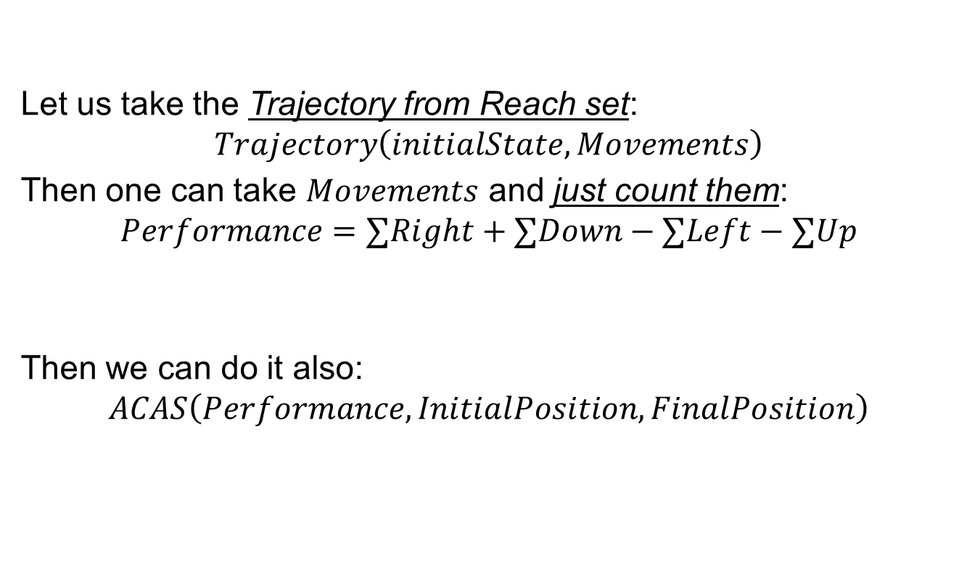
Prefer the vertical separation …
Let us take the Trajectory from Reach set:
$$Trajectory\left(initialState,Movements\right)$$
Then one can take $Movements$ and just count them:
$$Performance=∑Right+∑Down−∑Left−∑Up$$
Then we can do it also:
$$ACAS\left(Performance, InitialPosition, FinalPosition\right)$$
Cost function – go right and down preffered movement direction
But Lojzo, ACAS defines performance criterion
But Lojzo, ACAS tree is defined differently
Yes you are right, Let us define switching control

Slide 6
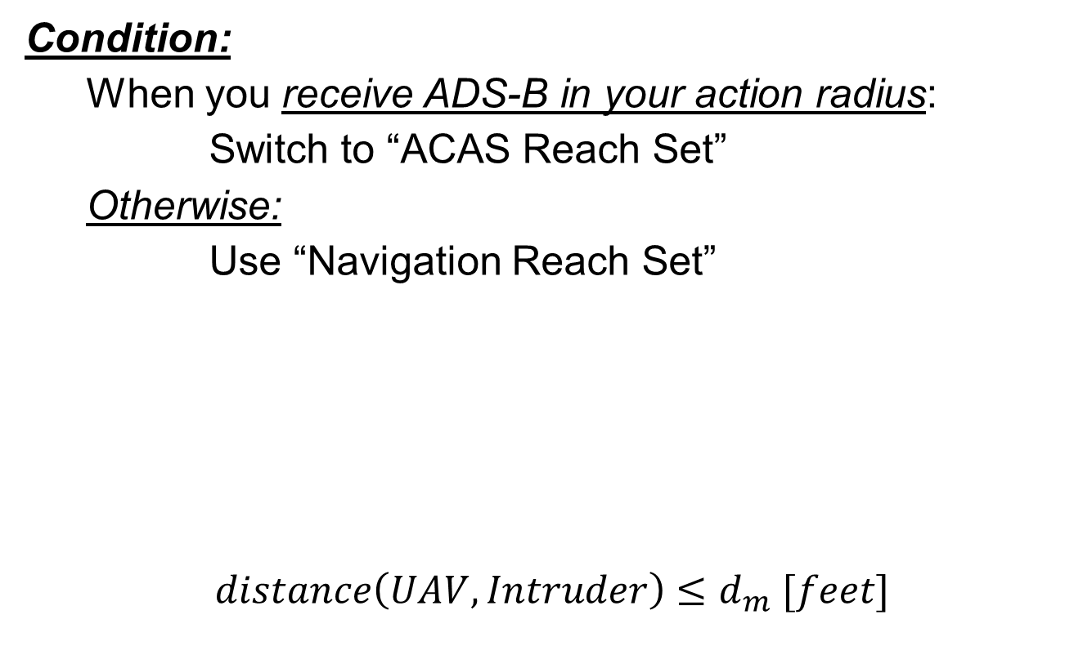
Switching control
Condition:
When you receive ADS-B in your action radius:
Switch to “ACAS Reach Set”
Otherwise:
Use “Navigation Reach Set”
$$distance\left(UAV,Intruder\right)≤d_{m} [feet]$$
That can do, what if different condition is given ?
ACAS is still under development, for this time let say that condition can be satisfied by hardcoded distance condition

Slide 7
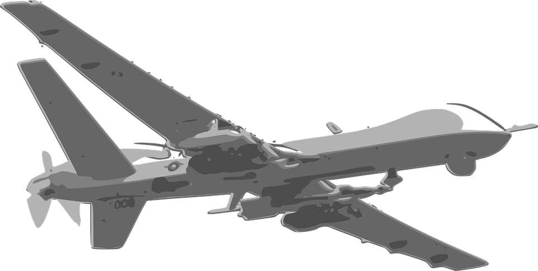
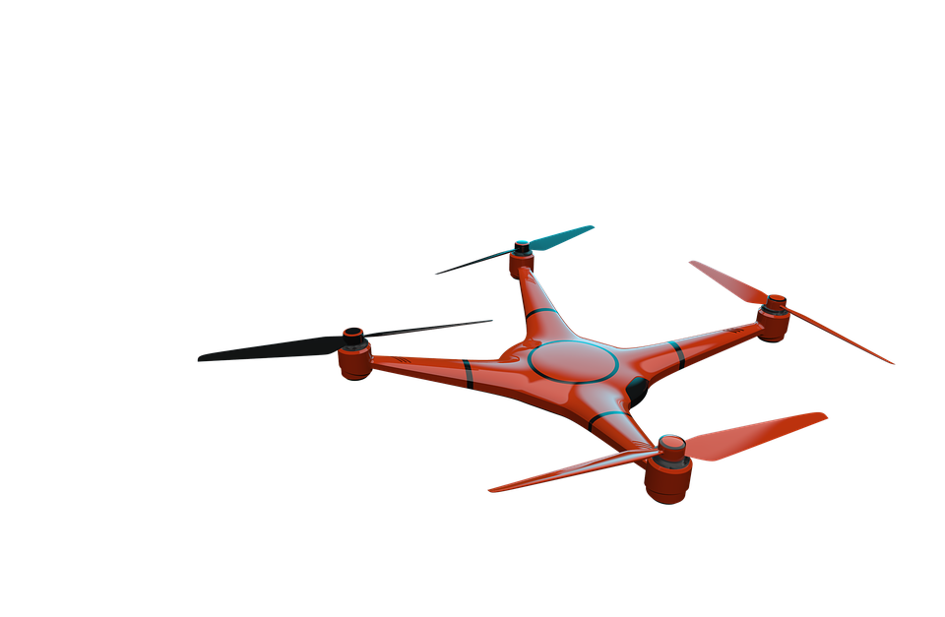
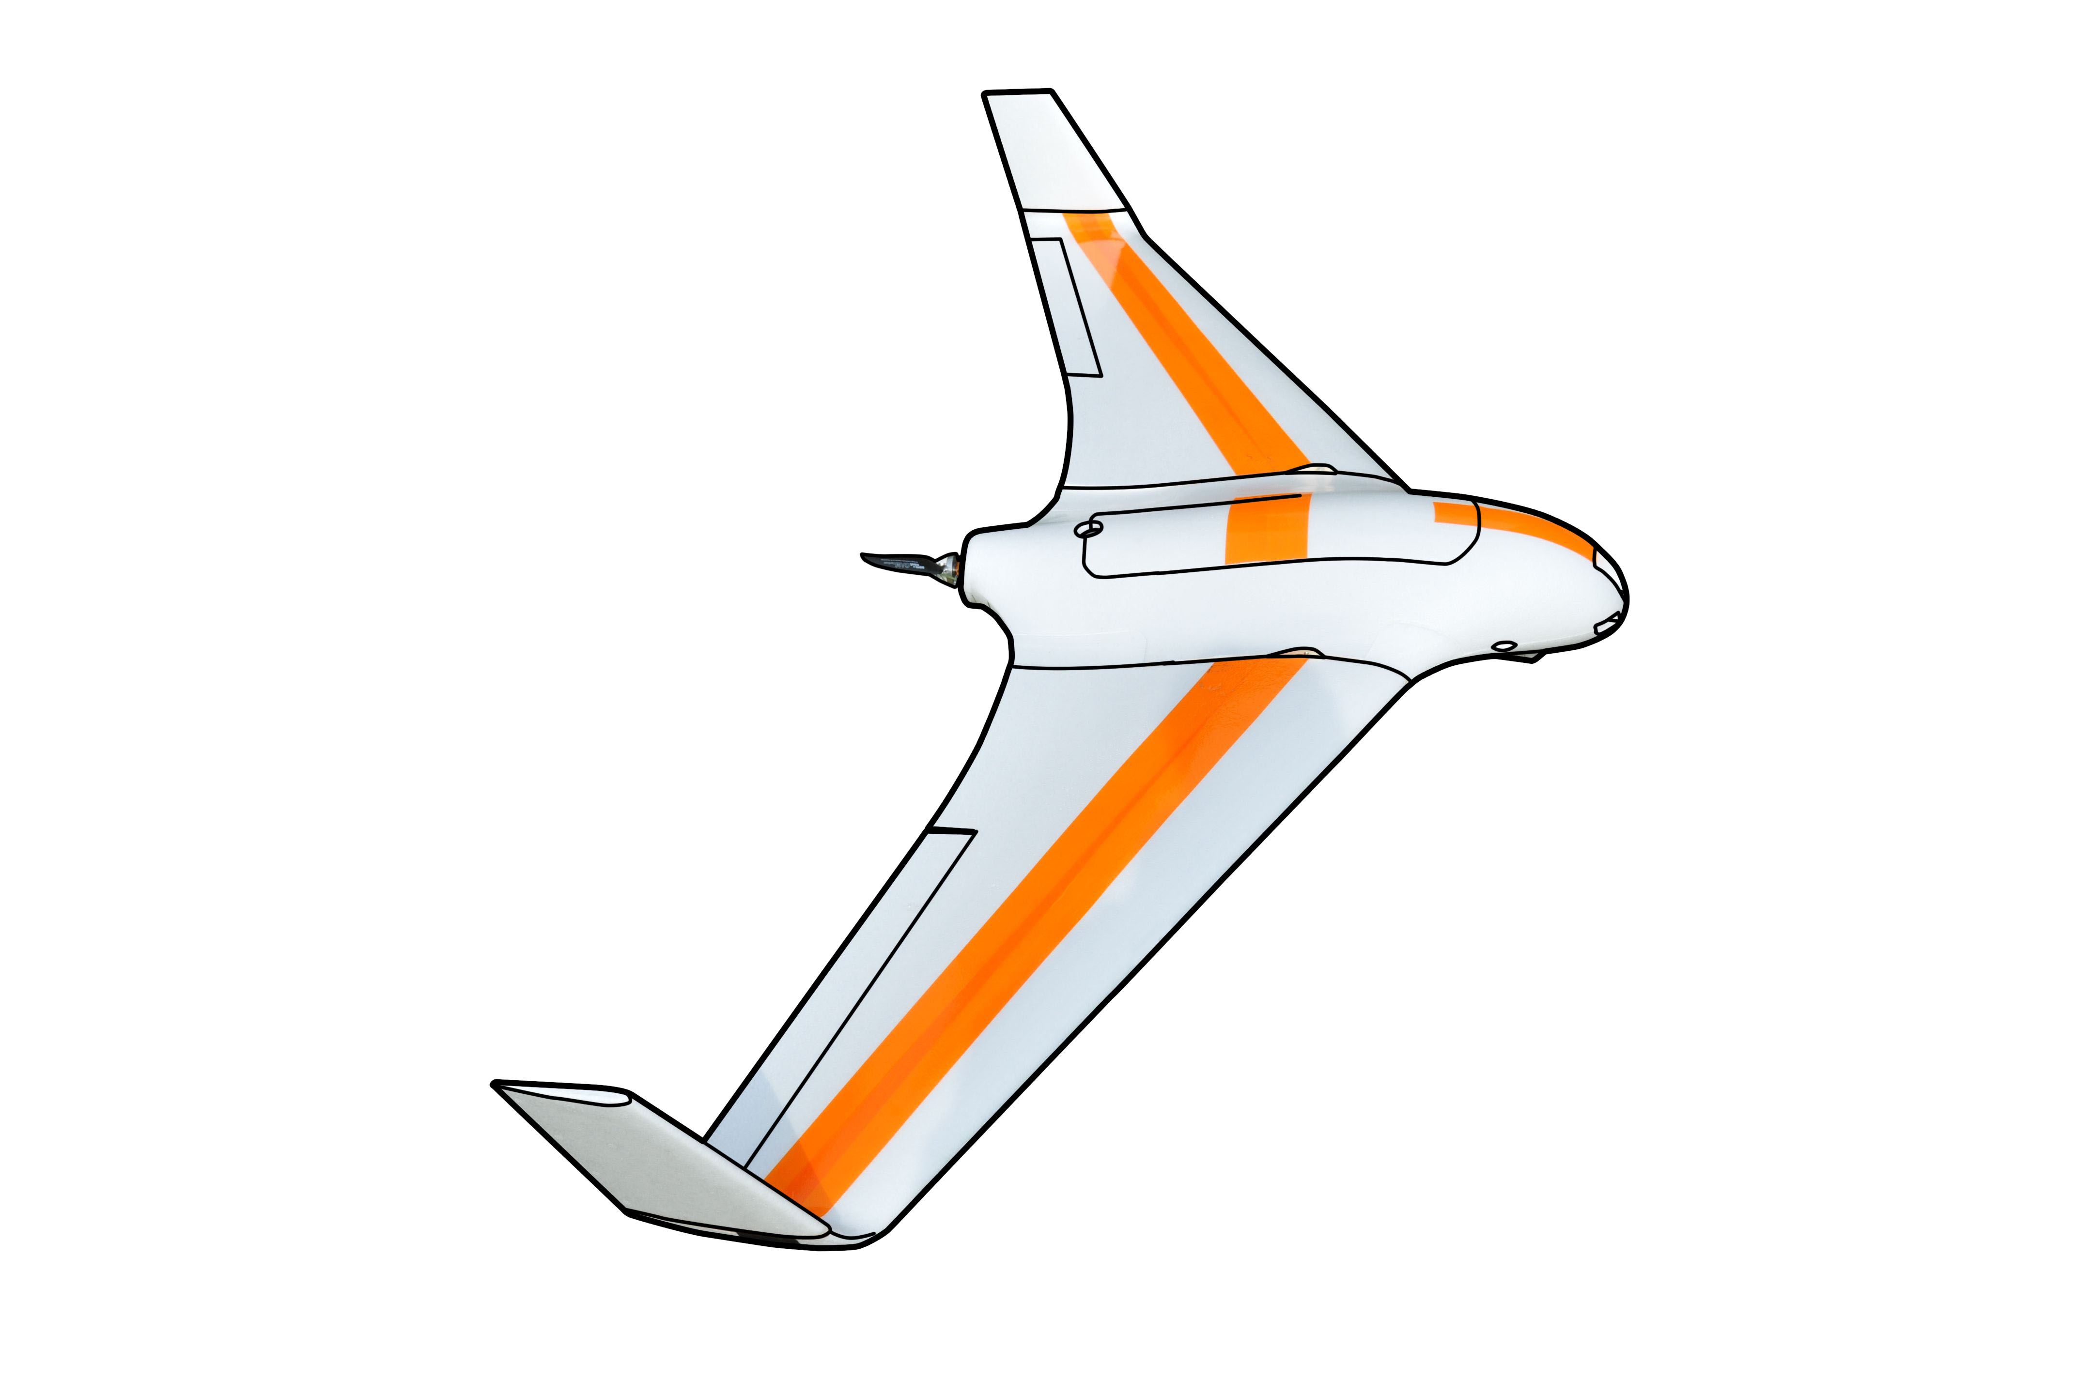
ACAS-Xu (Next generation safety framework)

Slide 8
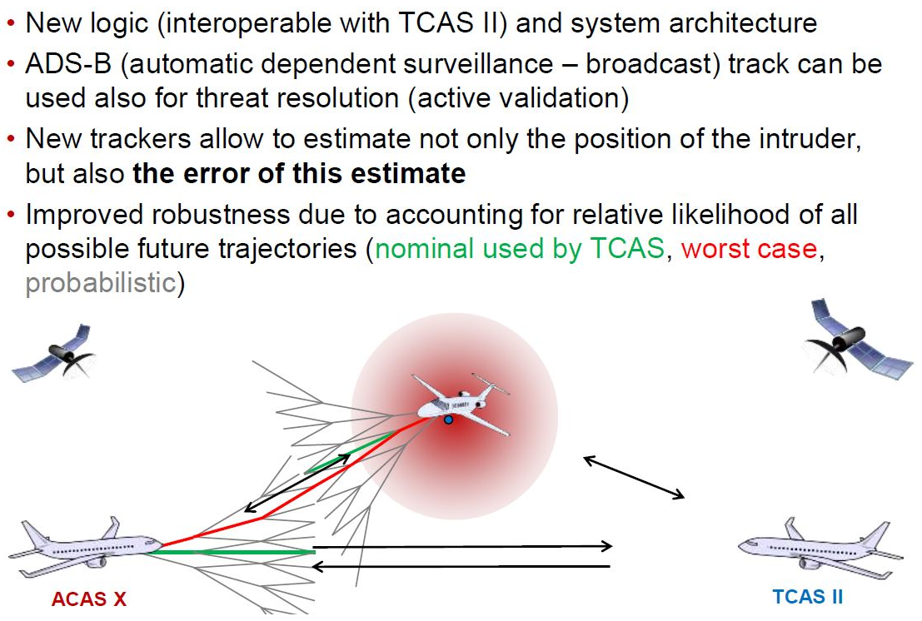
What is this ACAS ?

Slide 9
ACAS $X_{A}$ vs. ACAS $X_{U}$
$$\text{RTCA}\text{, }\text{SC}\text{−147, }\text{ACAS} \text{Xu} \text{WG} \text{Kick}\text{−}\text{off}\text{, }\text{January}\text{ 12, 2016}$$

Slide 10
ACAS $X_{A}$ vs. ACAS $X_{U}$
$$\text{RTCA}\text{, }\text{SC}\text{−147, }\text{ACAS} \text{Xu} \text{WG} \text{Kick}\text{−}\text{off}\text{, }\text{January}\text{ 12, 2016}$$

Slide 11
ACAS $X_{A}$ vs. ACAS $X_{U}$
$$\text{RTCA}\text{, }\text{SC}\text{−147, }\text{ACAS} \text{Xu} \text{WG} \text{Kick}\text{−}\text{off}\text{, }\text{January}\text{ 12, 2016}$$

Slide 12
Automatic response downfall
Depending on the communication link, it is expected that there may be significant latency associated with RA data transmission to a ground-based flight crew and subsequent pilot aircraft control commands back to the aircraft in response to the RA
Loss of uplink or downlink communications with the UAS would entirely prevent ground-controlled collision avoidance, and may also degrade collision avoidance effectiveness on other aircraft in coordinated encounters
UAS may also lack additional outside information, such as visual identification of intruders, which allows pilots in manned aircraft to make real-time decisions regarding RA response.
The pilot has the ability to override auto-response at any time before or after the aircraft has started maneuvering

Slide 13
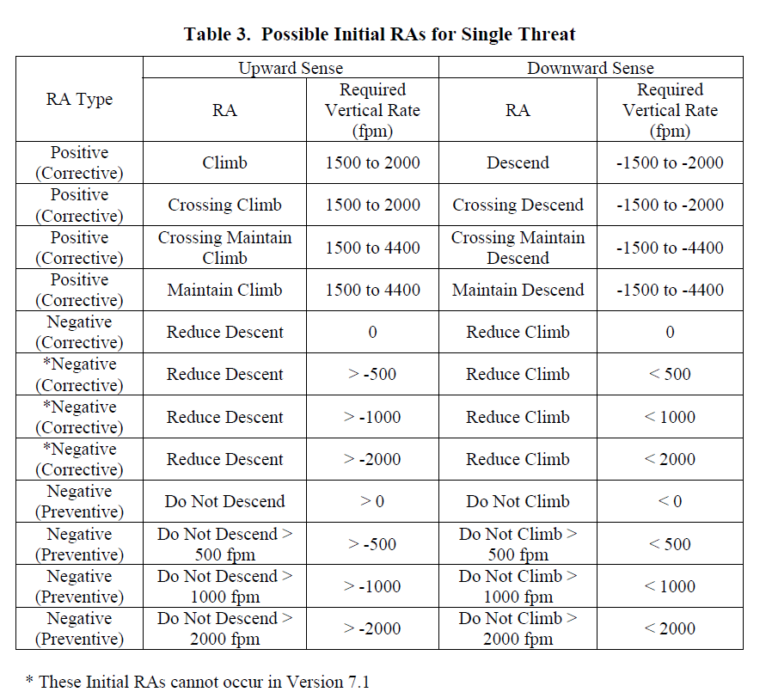
TCAS/ACAS RA advisories (!Horizontal only!)

Slide 14
ACAS Xu Summary
Safety – weather avoidance, mid air collisions
Strategic layer – flight planning (Hours/10^{ths} of minutes) [Mission plan]
Tactical layer – separation (10^{ths} of minutes/minutes) [Other systems]
Emergency layer – Collision avoidance (10^{ths} of seconds/seconds) (ACAS)
ACAS X merits to TCAS II limitations
Reducing nuisance alert rate while improving safety
New classes of users/Adaptation to new operations
Adaptable system allowing different sensors configuration
Backward compatibility with TCAS II
ACAS Xu should guarantee that UAV system does not enter RA zone of manned aviation
ACAS Xu provides look-up table for avoidance maneuvers on horizontal/vertical separation level, which determines vehicle behavior during avoidance
ACAS Xu is designed for big UAVs which are equipped with Transponder

Slide 15
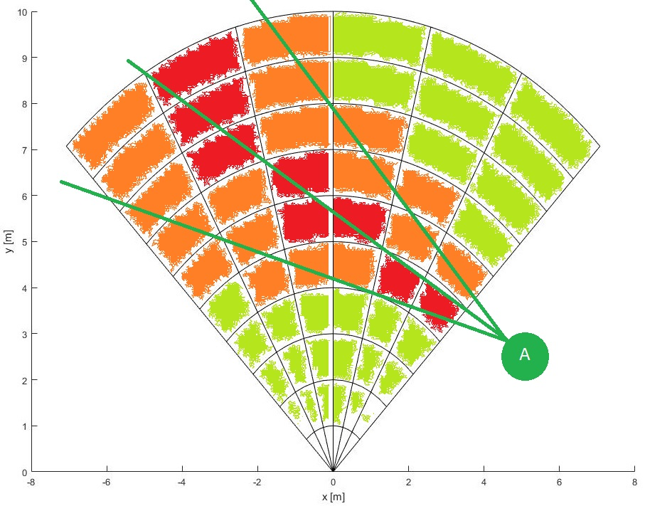
Intruder Intersection (Body volume, Spread)

Slide 16
Body volume intersection
Intruder can have body volume,
Obstacle probability using polygon intersection
Cell radius search is implemented as spread algorithm to address time deviation intersection issues
Intruder body volume can be only applied to direct intersection cells
Example considers body radius of 1 m

Slide 17
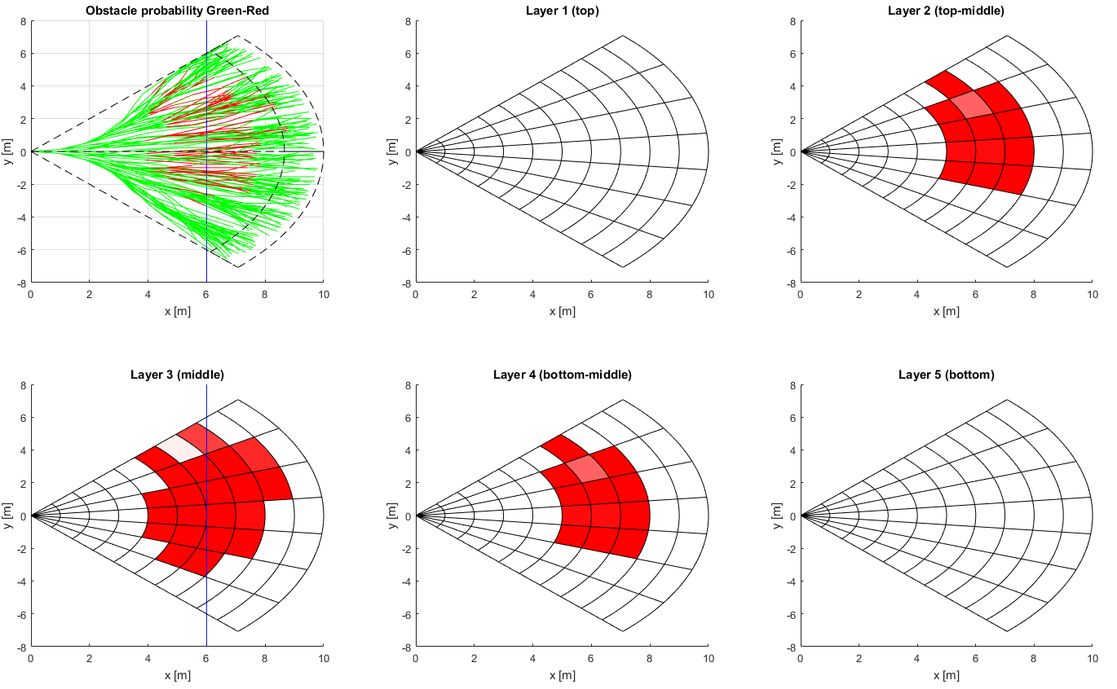
Obstacle space - Intruder body

Slide 18
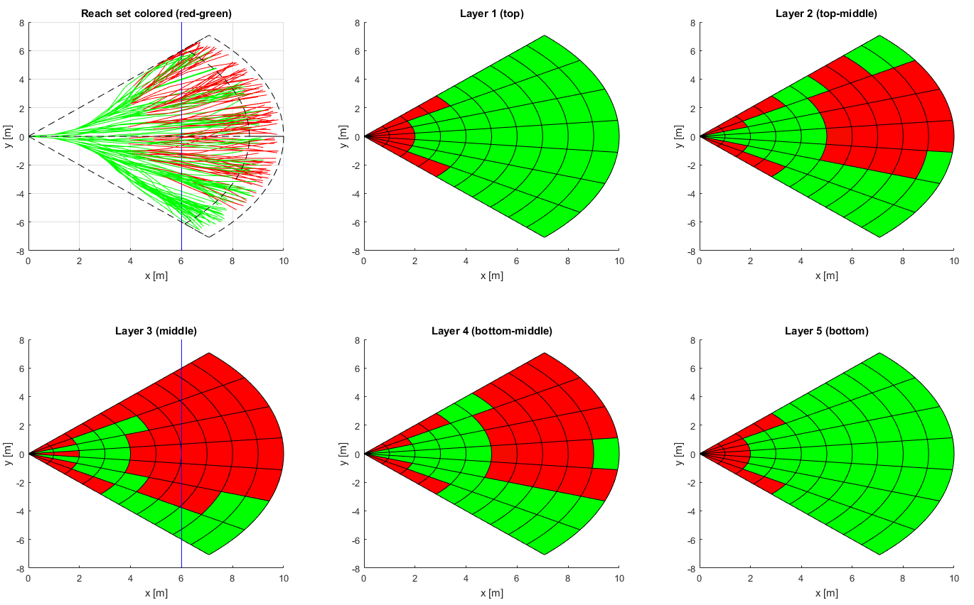
Reach set approximation - Intruder body

Slide 19
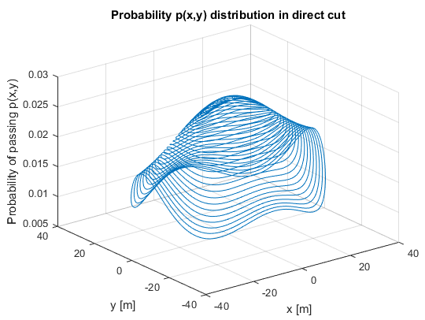
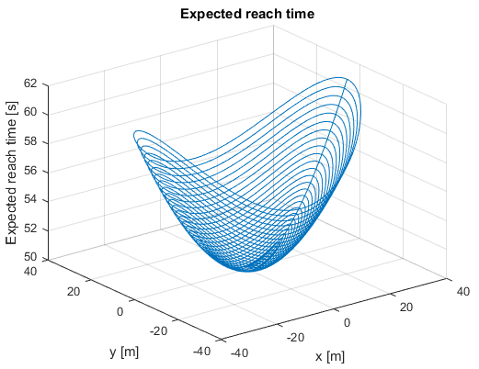
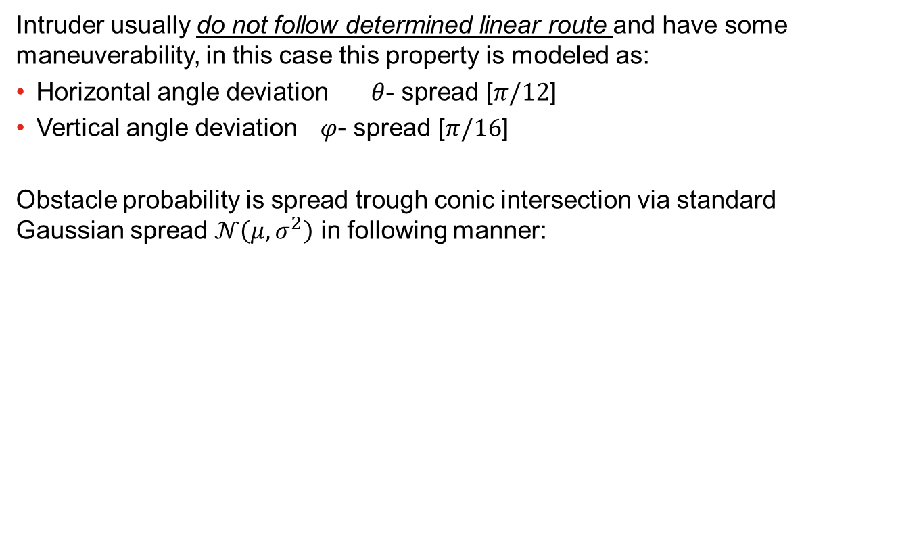
Intruder Trajectory Deviation Model
Intruder usually do not follow determined linear route and have some maneuverability, in this case this property is modeled as:
Horizontal angle deviation $θ$- spread [$π/12$]
Vertical angle deviation $φ$- spread [$π/16$]
Obstacle probability is spread trough conic intersection via standard Gaussian spread $𝒩\left(μ,σ^{2}\right)$ in following manner:

Slide 20
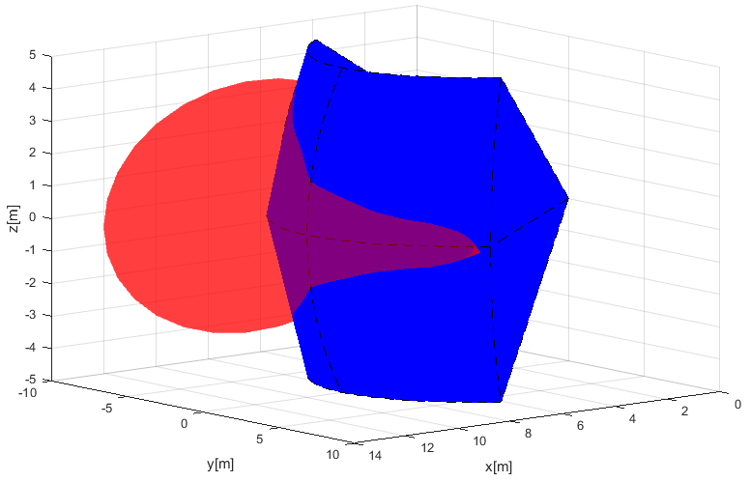
Spread Intersection Examples

Slide 21
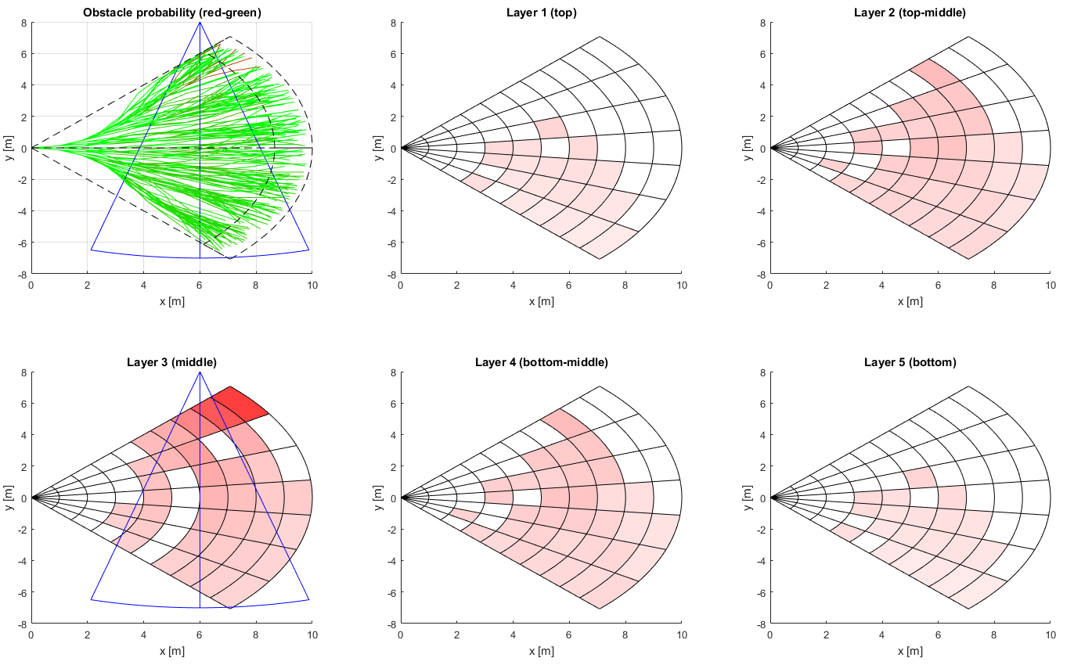
Obstacle space - Intruder spread (Static)

Slide 22
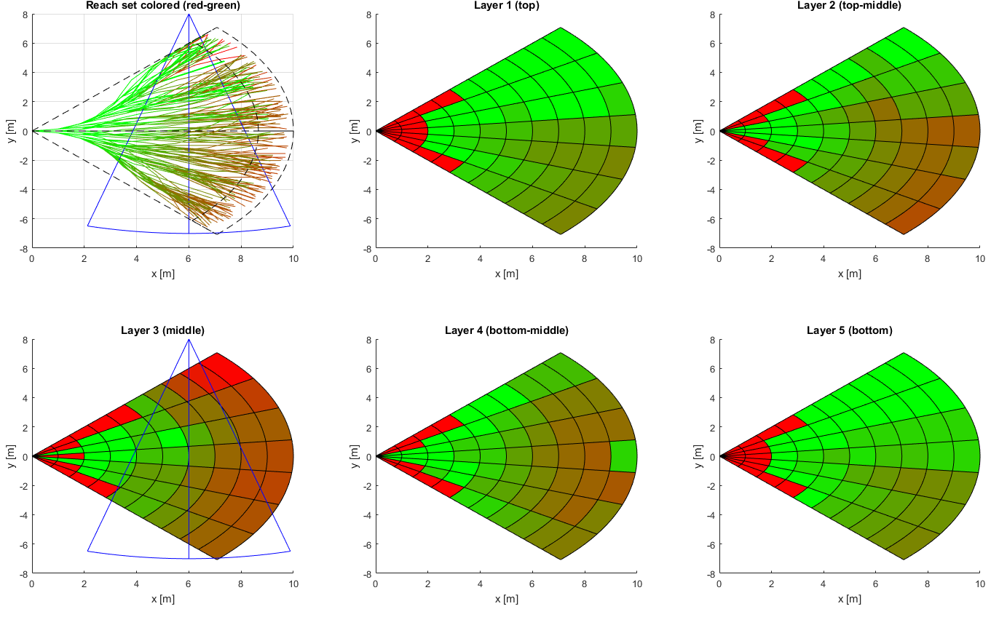
Reach set – Intruder spread (Static)

Slide 23
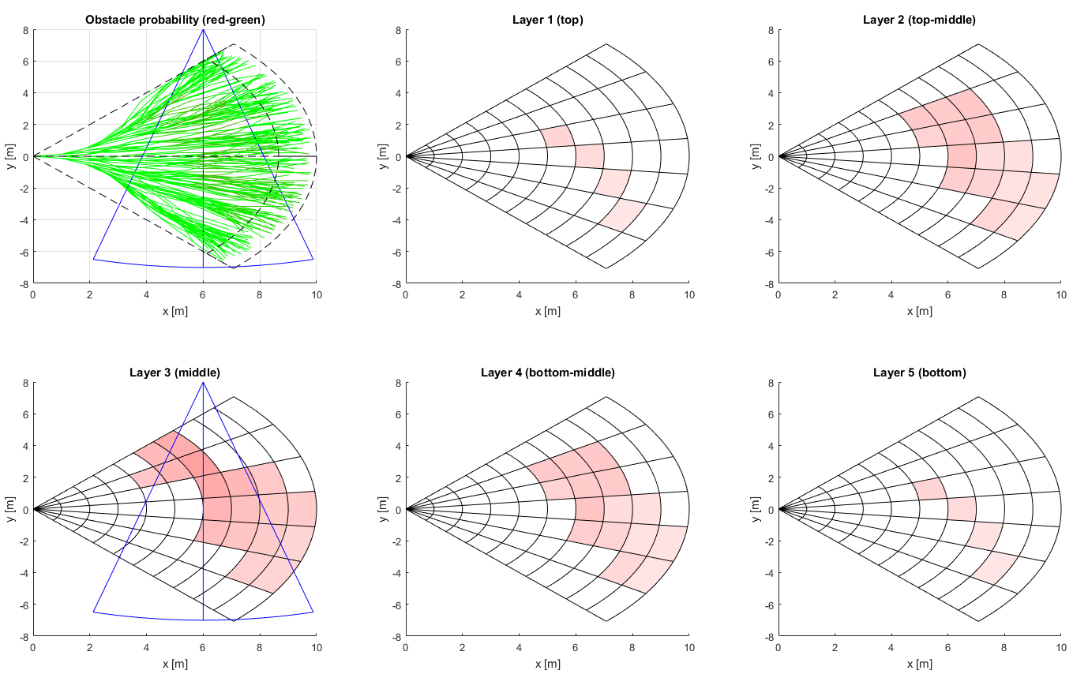
Obstacle space - Intruder spread (Timed)

Slide 24
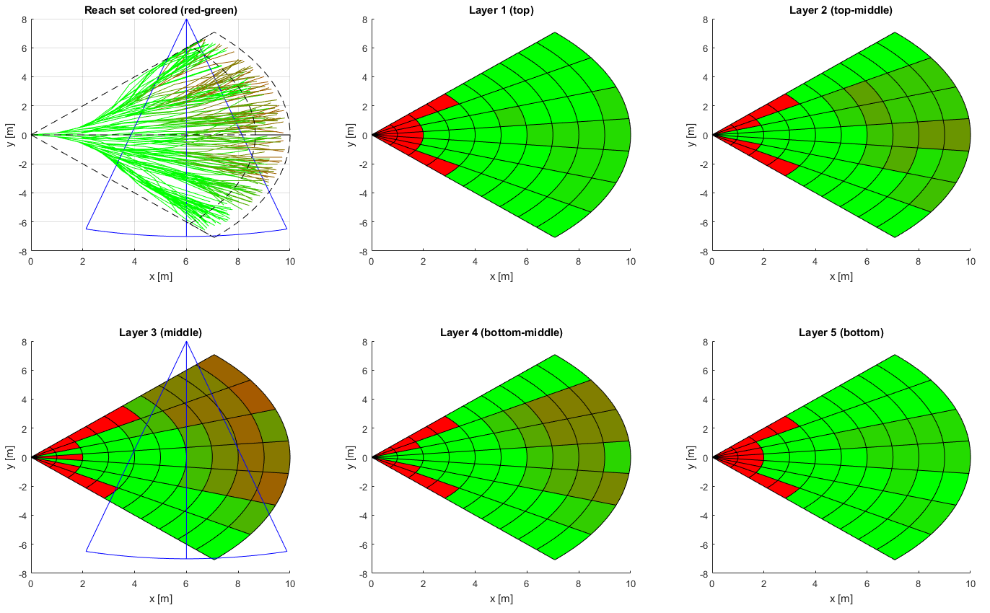
Reach set - Intruder spread (Timed)

Slide 25
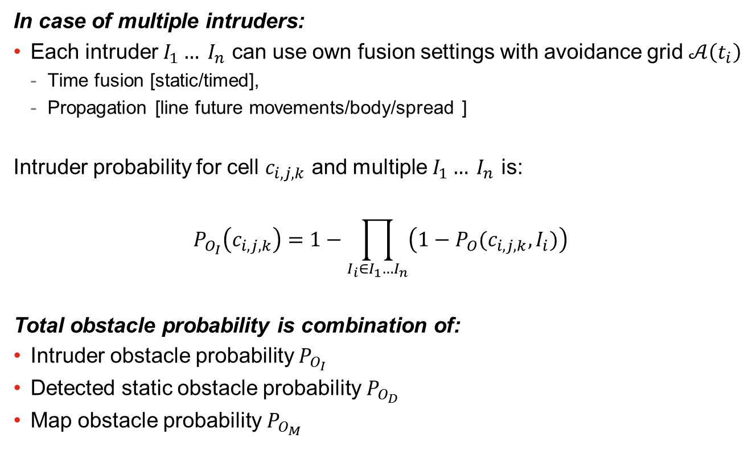
Intruder probability calculation
In case of multiple intruders:
Each intruder $I_{1}… I_{n}$ can use own fusion settings with avoidance grid $𝒜\left(t_{i}\right)$
Time fusion [static/timed],
Propagation [line future movements/body/spread ]
Intruder probability for cell $c_{i,j,k}$ and multiple $I_{1}… I_{n}$ is:
$$P_{O_{I}}\left(c_{i,j,k}\right)=1−\prod_{I_{i}∈I_{1}…I_{n}}{\left(1−P_{O}(c_{i,j,k},I_{i})\right)}$$
Total obstacle probability is combination of:
Intruder obstacle probability $P_{O_{I}}$
Detected static obstacle probability $P_{O_{D}}$
Map obstacle probability $P_{O_{M}}$

Slide 26

Simulations

Slide 27
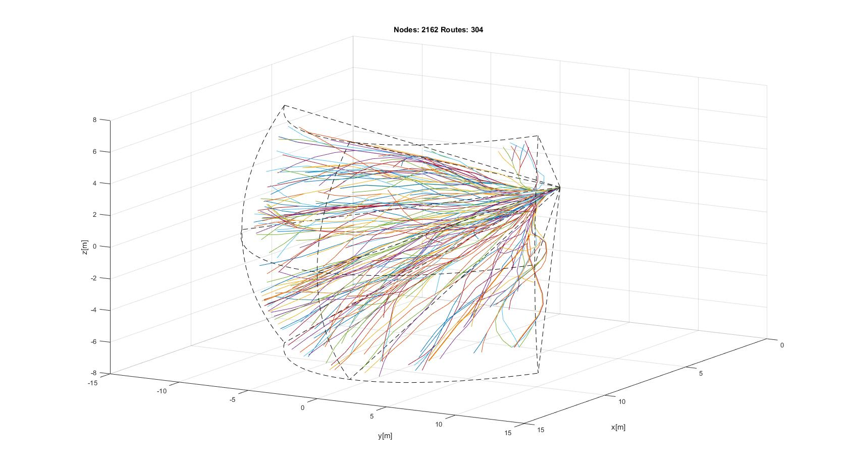
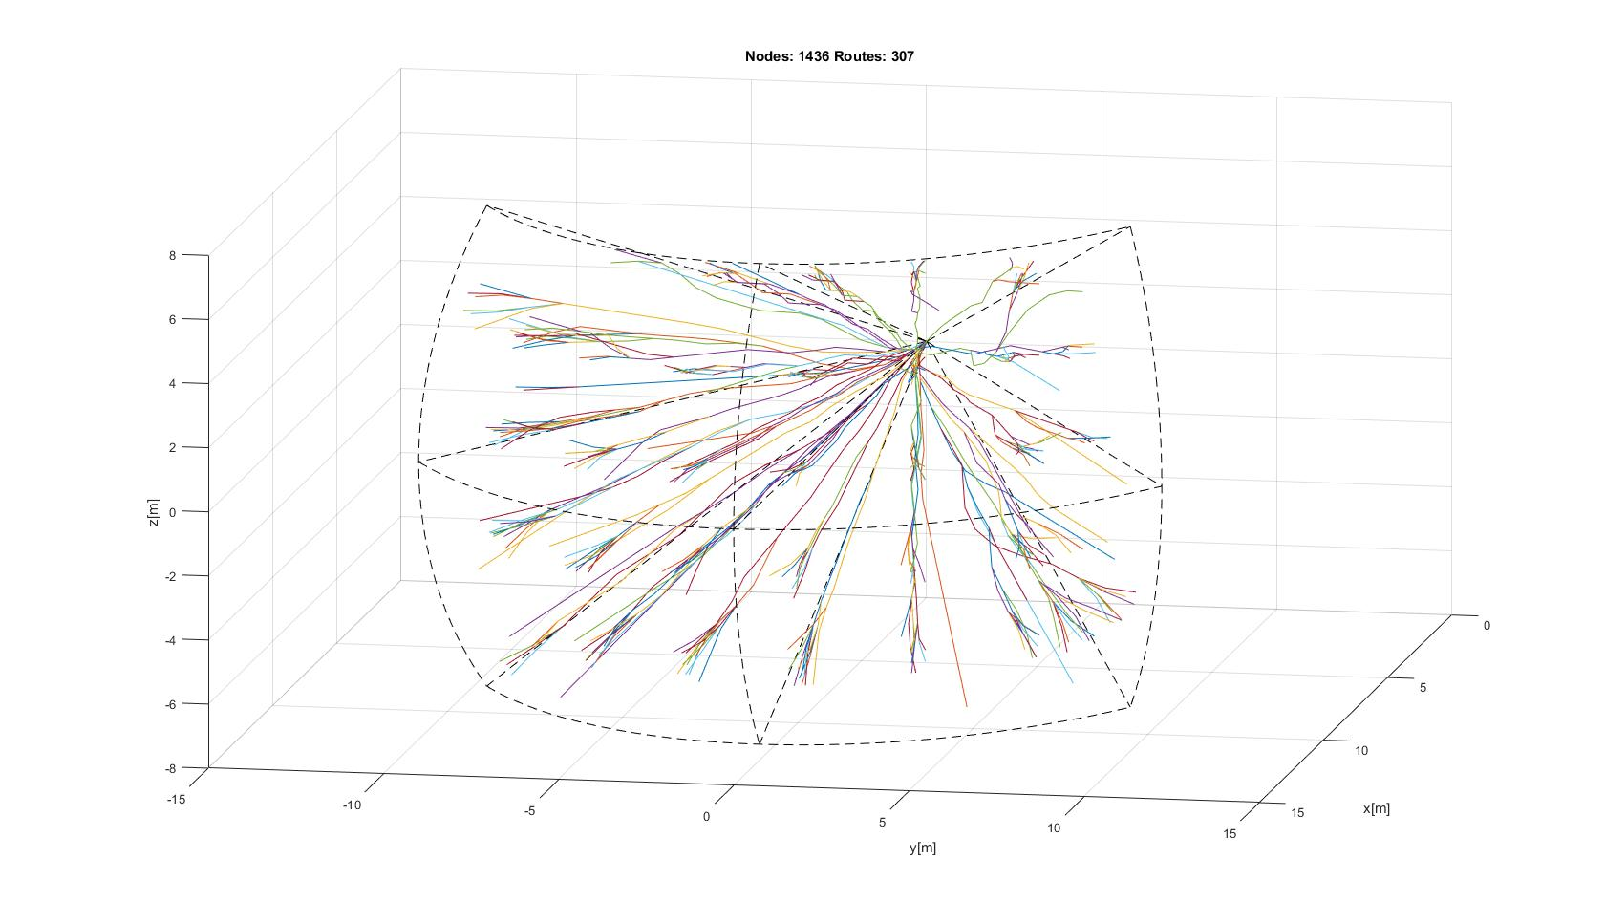
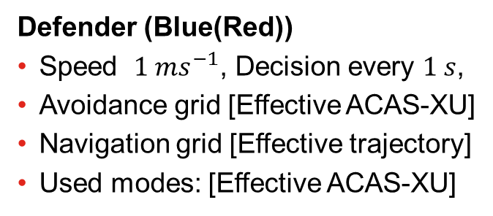
Avoidance Framework Setup
Defender (Blue(Red))
Speed $1 ms^{−1}$, Decision every $1 s$,
Avoidance grid [Effective ACAS-XU]
Navigation grid [Effective trajectory]
Used modes: [Effective ACAS-XU]
Effective Trajectory
Effective ACAS-XU

Slide 28
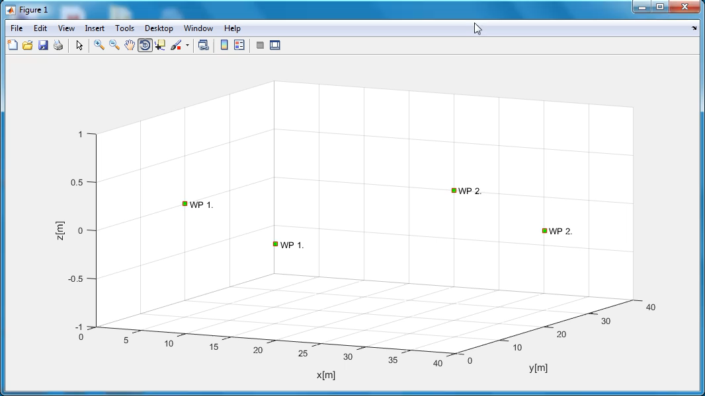
Same speed as intruder with “Right of the way”

Slide 29
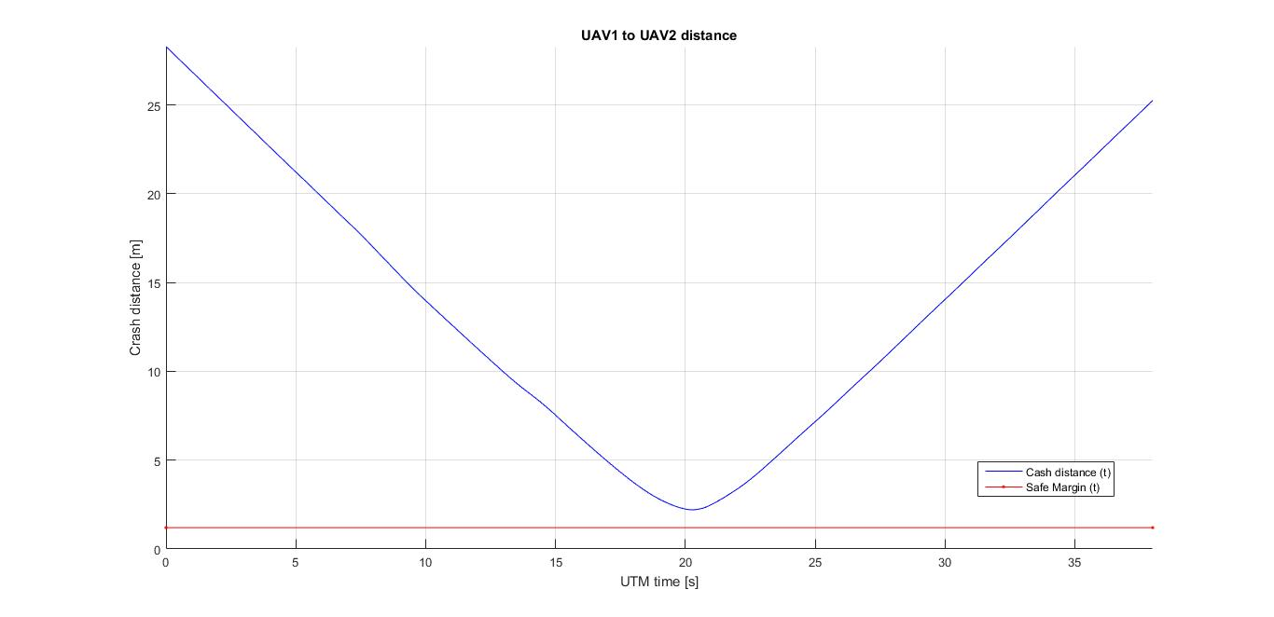
Crash distance $d_{c}\left(t\right)$ evolution (Normal ACAS)

Slide 30
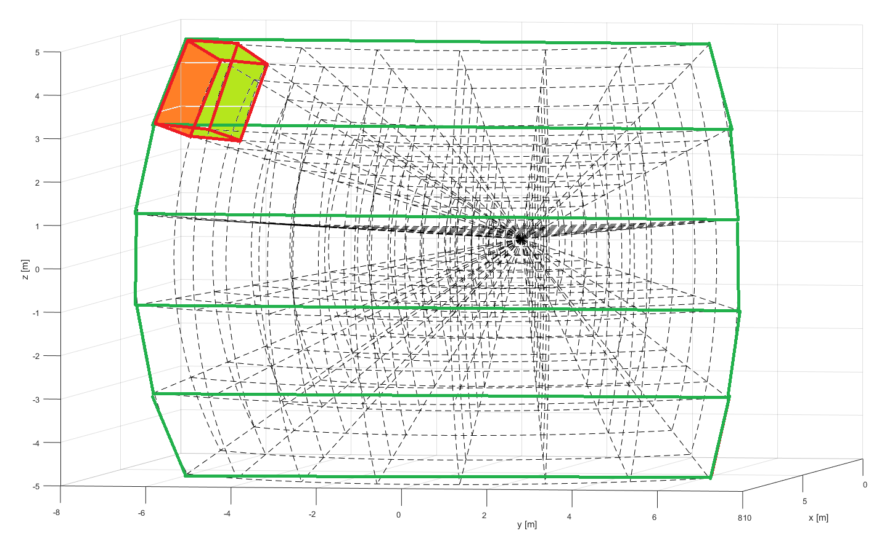
Avoidance Grid Setup
Cell (10,1,1)
Top
Top-Middle
Horizontal layers
Middle
Bottom-middle
Bottom

Slide 31
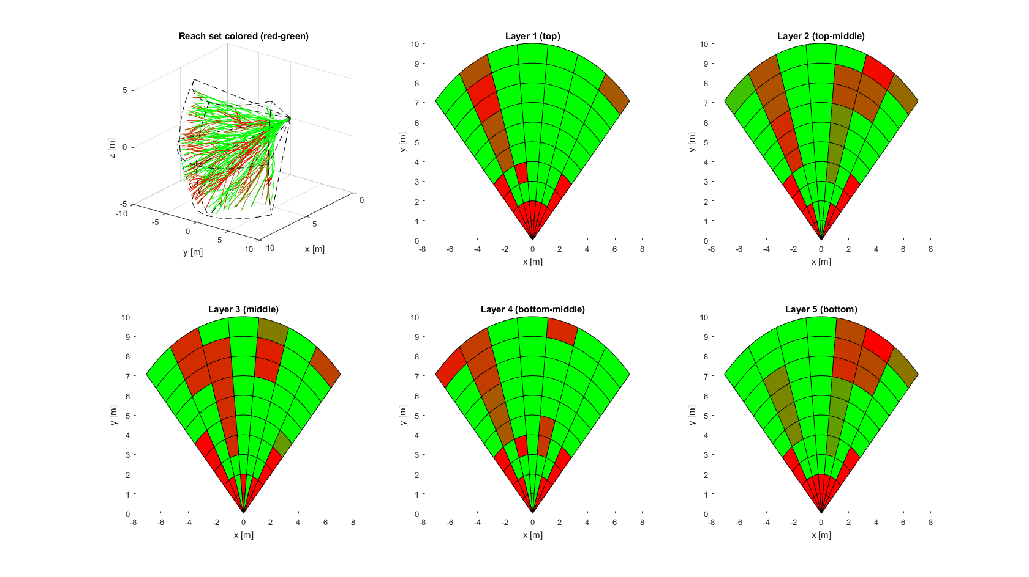
Avoidance Grid - Legend
Reach set approximation
Reachability = 0
Middle layer
Reachability < 1
Reachability = 1

Slide 32
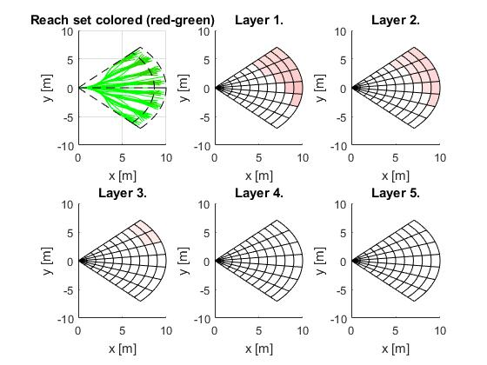
Decision Frame 5 (Obstacle Space)

Slide 33
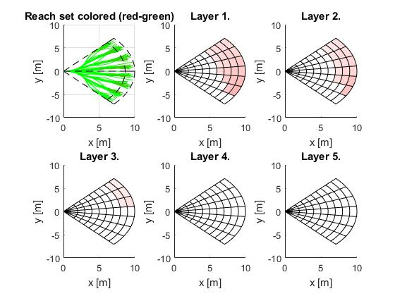
Decision Frame 6 (Obstacle Space)

Slide 34
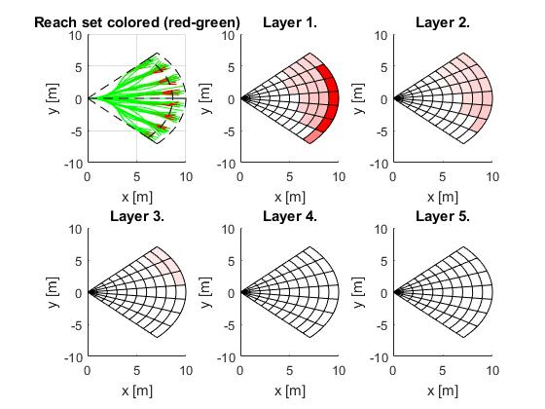
Decision Frame 7 (Obstacle Space)

Slide 35
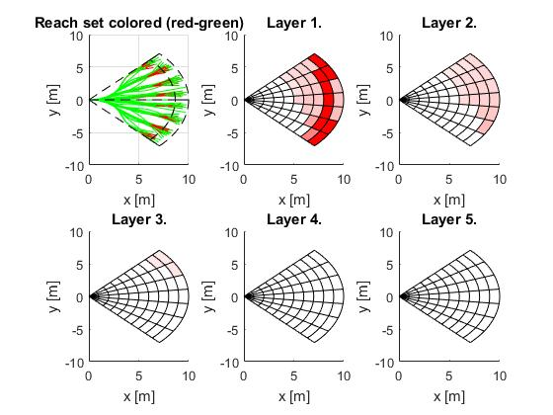
Decision Frame 8 (Obstacle Space)

Slide 36
Decision Frame 9 (Obstacle Space)

Slide 37
Decision Frame 10 (Obstacle Space)

Slide 38
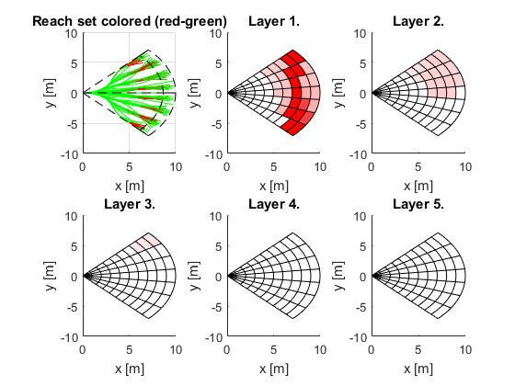
Decision Frame 11 (Obstacle Space)

Slide 39
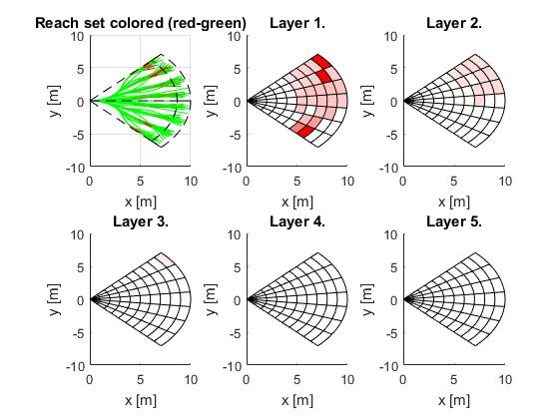
Decision Frame 12 (Obstacle Space)

Slide 40
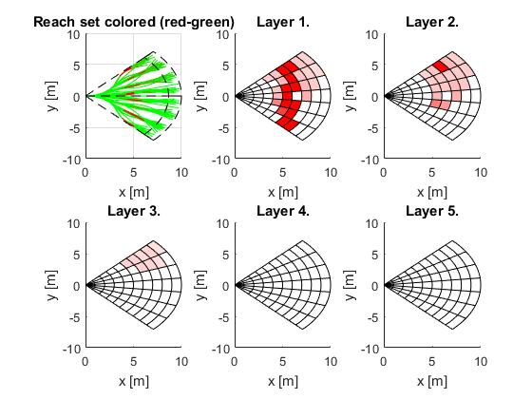
Decision Frame 13 (Obstacle Space)

Slide 41
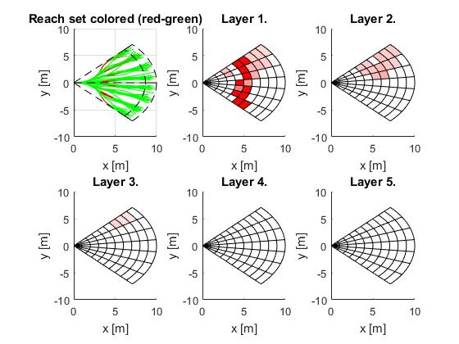
Decision Frame 14 (Obstacle Space)

Slide 42
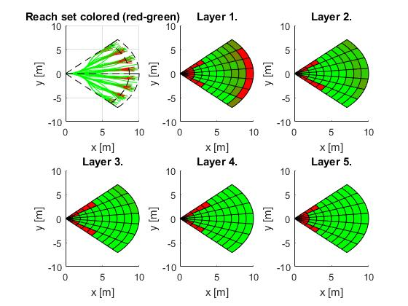
Decision Frame 7 (Reachable Space)

Slide 43
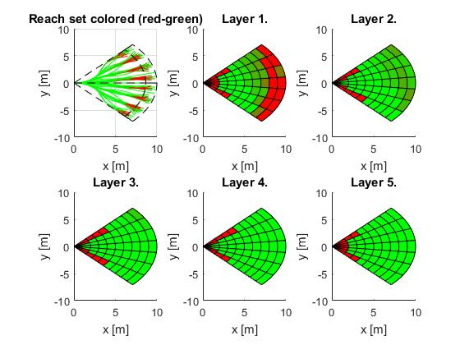
Decision Frame 8 (Reachable Space)

Slide 44
Decision Frame 9 (Reachable Space)

Slide 45
Decision Frame 10 (Reachable Space)

Slide 46
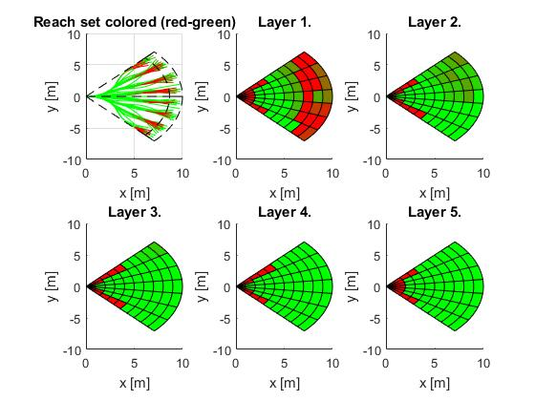
Decision Frame 11 (Reachable Space)

Slide 47
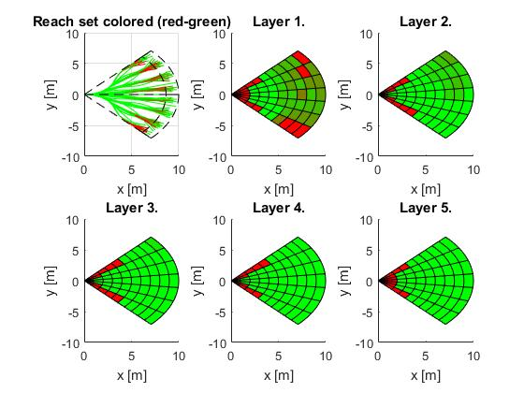
Decision Frame 12 (Reachable Space)

Slide 48
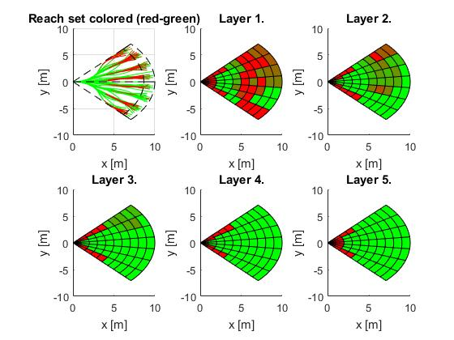
Decision Frame 13 (Reachable Space)

Slide 49
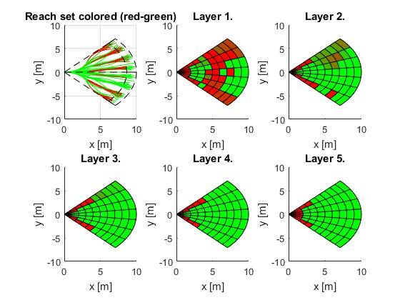
Decision Frame 14 (Reachable Space)

Slide 50
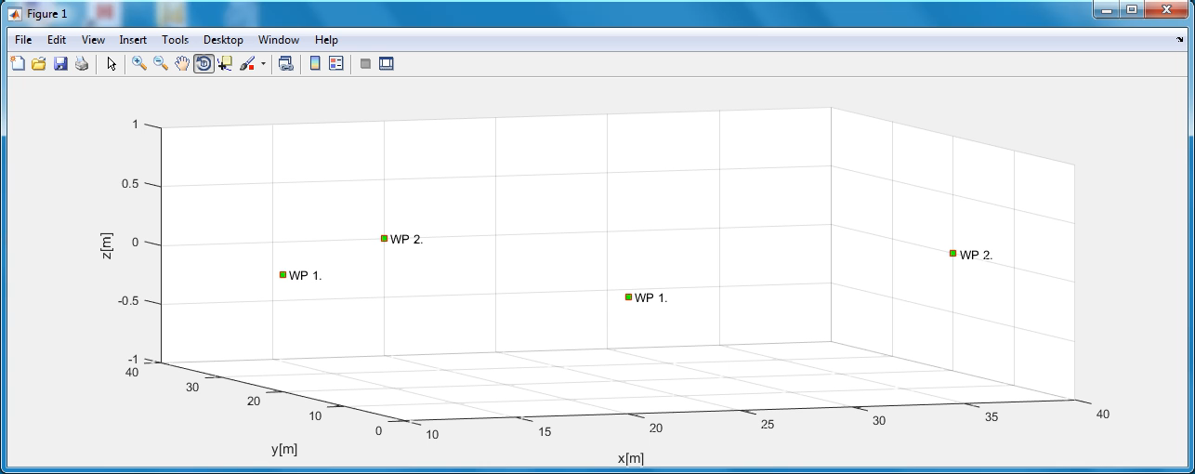
Slower speed as intruder with “Right of the way”

Slide 51
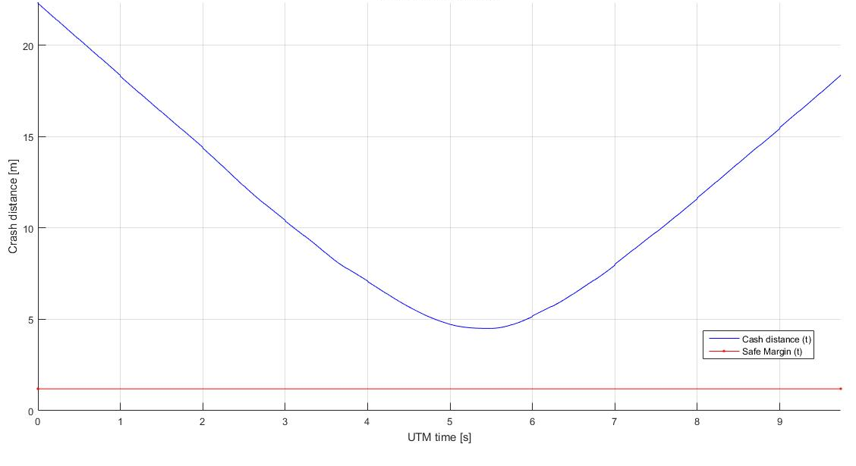
Crash distance $d_{c}\left(t\right)$ evolution (Normal ACAS)

